Slide 1


FACTORS BEHIND CHICAGO CRIMES
Jianan Fei, Yue Sun,
Ruobing Xue, Kaihao Fan
(Group 4: Future Splendid & X-Fabulous )
December 2020

Slide 2




MEET THE TEAM
Jianan Fei
Kaihao Fan
Ruobing Xue
Yue Sun
feij@uchicago.edu
kaihaofan@uchicago.edu
ruobing@uchicago.edu
yus002@uchicago.edu

Slide 3

CONTENT
Executive Summary
Business Use Case
Sources & Tools
Data ETL
Relational Model EER & Dimensional Model
Reporting
Recommendations
Lessons learned
Appendix

Slide 4

Executive Summary
Introduction
Solution Overview
ETL/Data Model
Insights
Conclusions
Collecting data from various data source and merging to single data warehouse, then conducting analyzation and visualization by multiple data tools learned in Data Engineering Platform, nail down factors behind the crimes of Chicago City.
The purpose of this project is to provide valuable insights to citizens of Chicago and public service departments to relieve public safety pressure and help residents to understand trends of crimes at Chicago with tips.

Slide 5


Business Use Case
Introduction
Solution Overview
ETL/Data Model
Insights
Conclusions
PROBLEM
O Identify and analyze factors behind Chicago crimes
MOTIVATION
O Citizens of Chicago can understand which factors may influence crime rates at specific area
O Helpful to protect personal and property safety
O Public service departments can better understand hidden factors
O Implement better initiatives to enhance the security of Chicago

Slide 6












Introduction
Solution Overview
ETL/Data Model
Insights
Conclusions
Sources & Tools
Sources
Ingestion & Cleaning
Warehousing
Visualization & Analytics
Portal: Chicago Public Safety-Crimes
Open Refine
Google Cloud Platform
Tableau
Kepler
Microsoft Excel
SQL
External: Chicago Demographic
Mapbox
Python
neo4j
MongoDB
Python

Slide 7
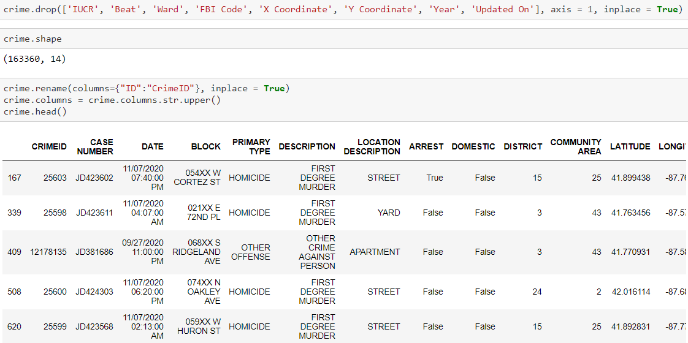
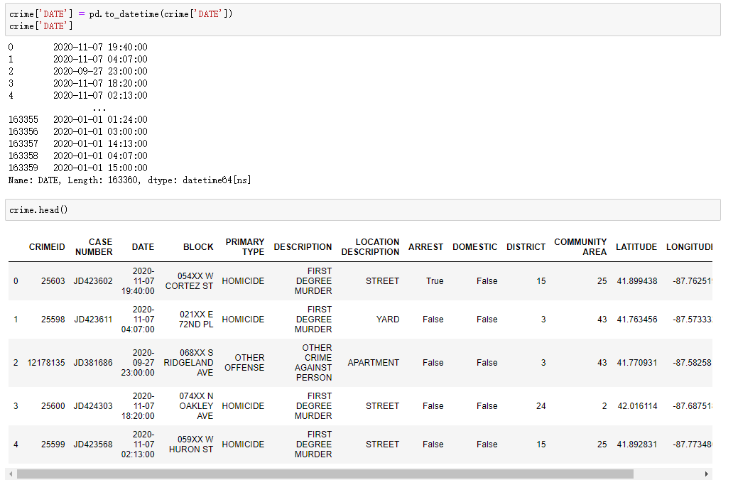
DATA Cleaning: Crime 2020
Introduction
Solution Overview
ETL/Data Model
Insights
Conclusions
Python:
Drop columns that have missing values
Rename ID to CrimeID to avoid confusion
Convert all column names to uppercase
Change DATE column to TimeStamp

Slide 8
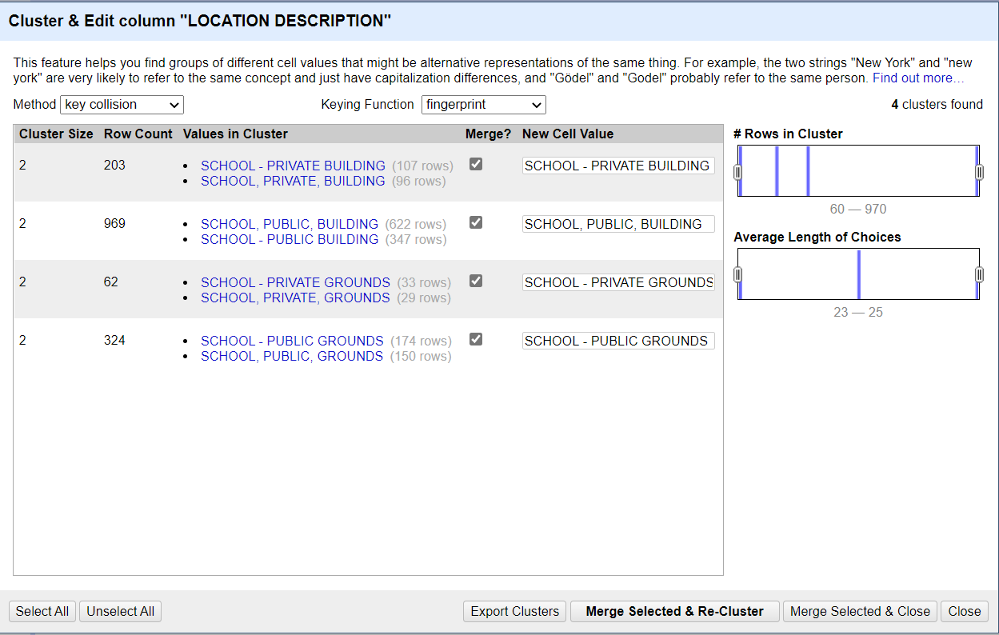
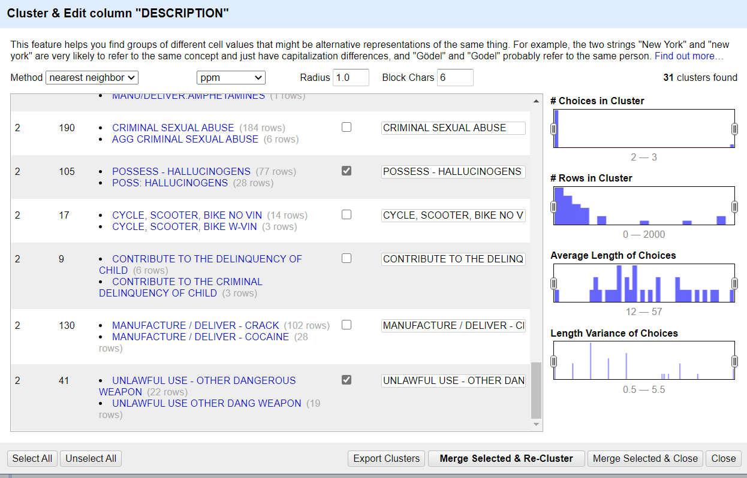
DATA Cleaning: Crime 2020
Introduction
Solution Overview
ETL/Data Model
Insights
Conclusions
OpenRefine:
Merge different cell values

Slide 9
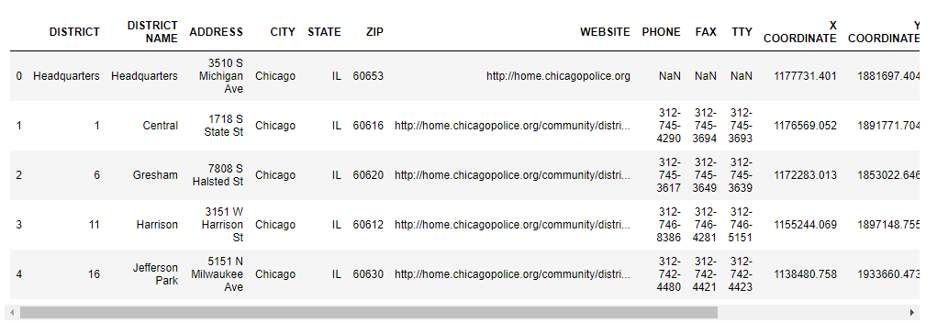
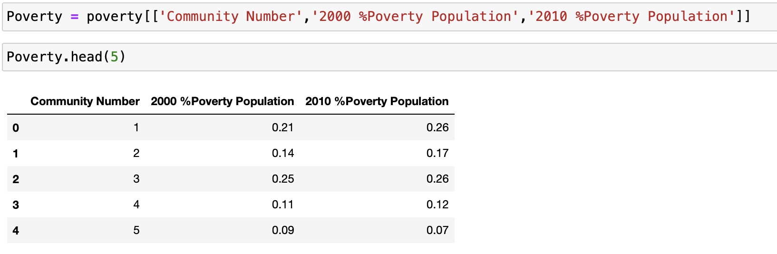
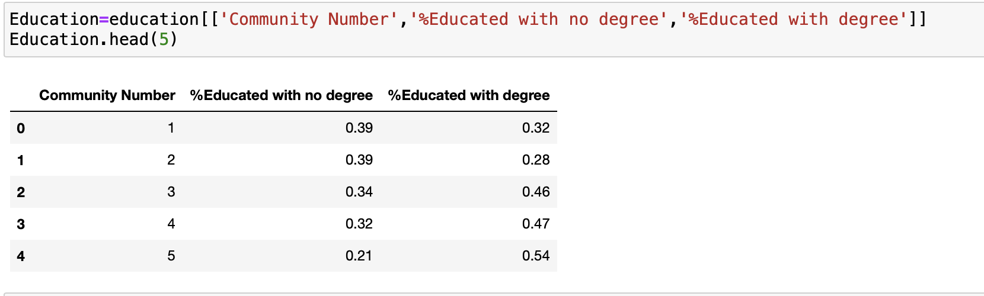
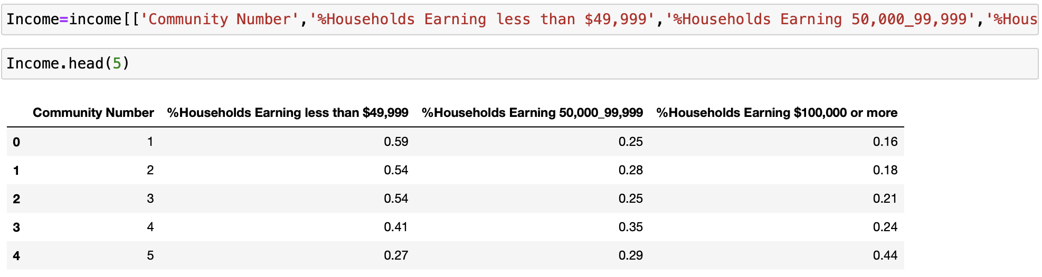
DATA Cleaning: Chicago Police Stations & Demographic
Introduction
Solution Overview
ETL/Data Model
Insights
Conclusions
Python:
Change district ‘Headquarters’ to 31 (31 comes from another file with district code)
Drop columns:['X COORDINATE', 'Y COORDINATE', 'CITY', 'STATE'] 4 columns in total
Drop columns that have missing values
Keep columns to be analyzed and merge some columns
Drop other columns.

Slide 10
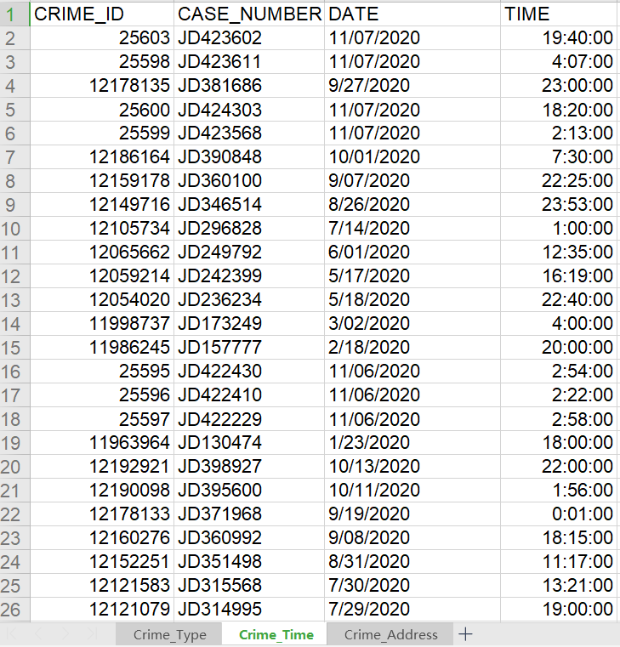
Relational Model Normalization
Introduction
Solution Overview
ETL/Data Model
Insights
Conclusions
Normalize the cleaned Crime table

Slide 11
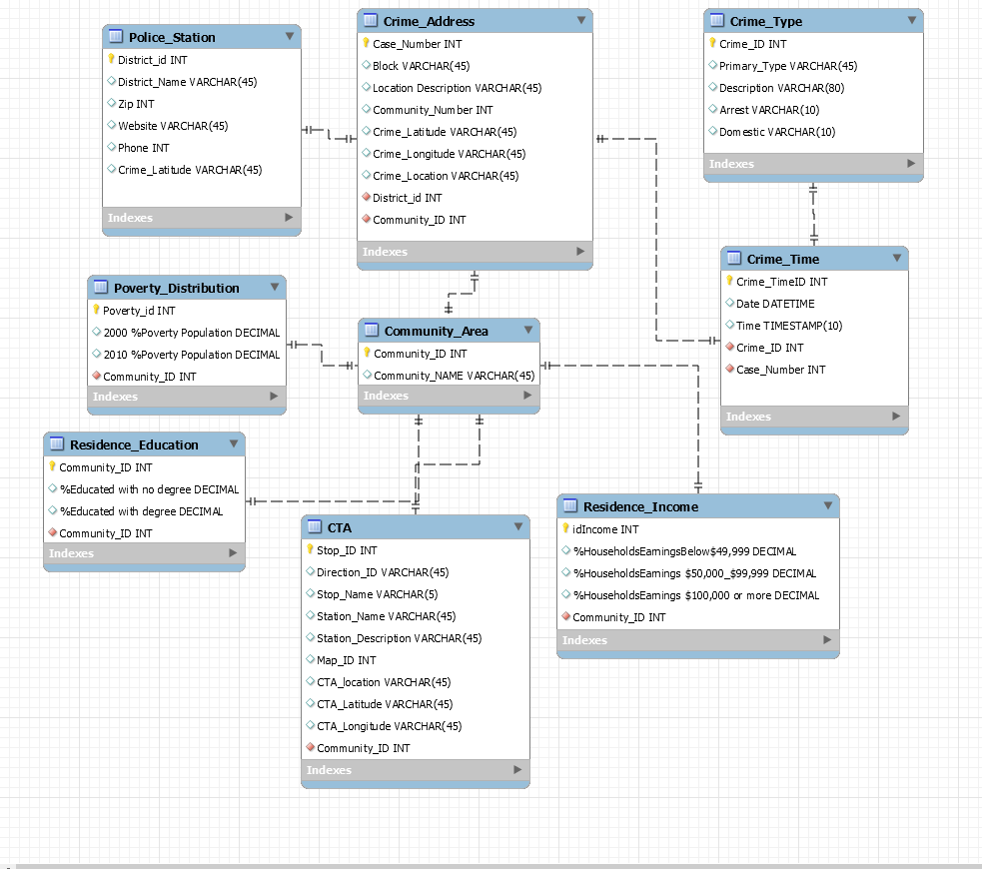
Introduction
Solution Overview
ETL/Data Model
Insights
Conclusions
Relational Model
EER

Slide 12
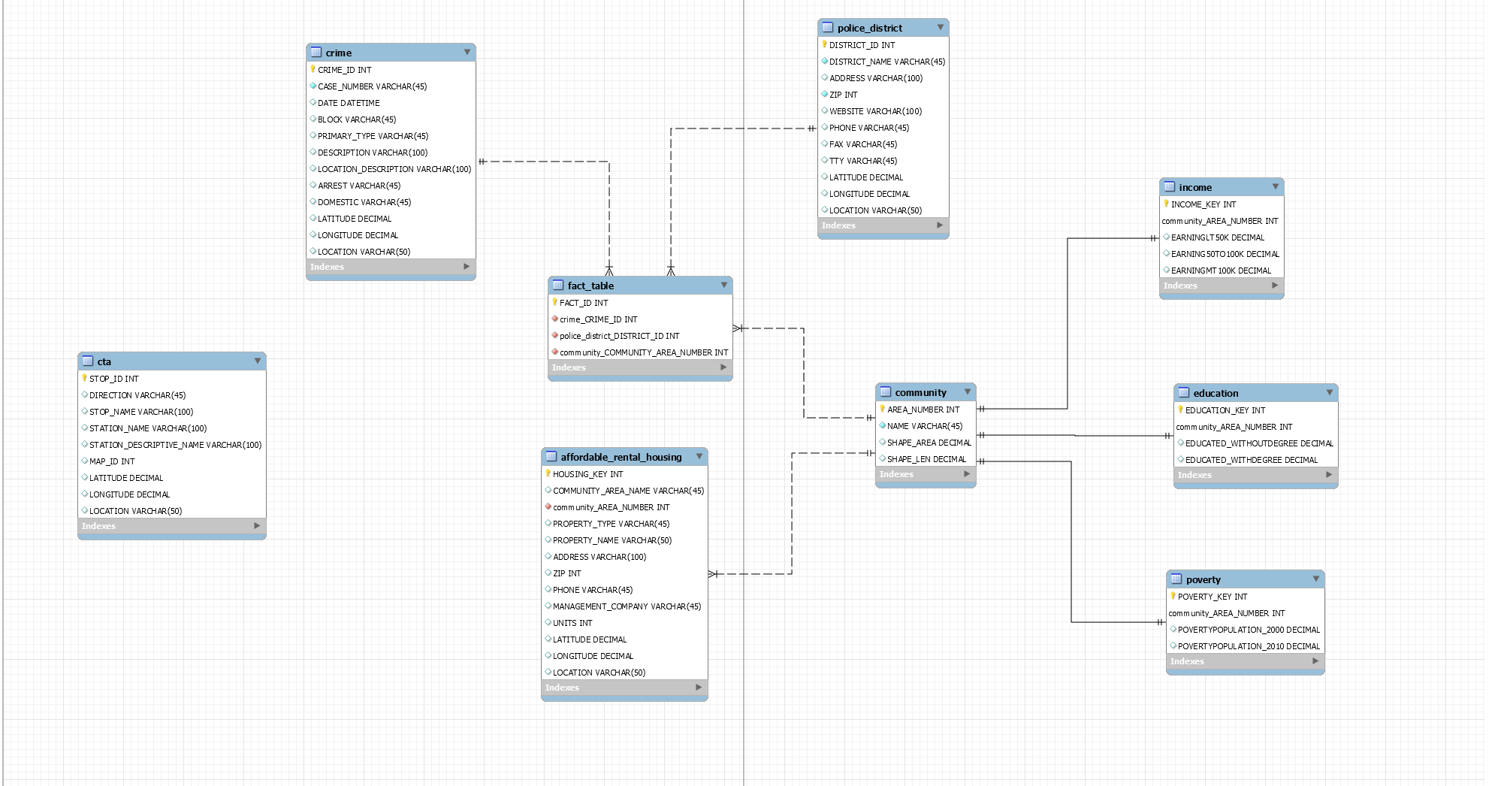
Introduction
Solution Overview
ETL/Data Model
Insights
Conclusions
Dimensional Model
Notes:
改format

Slide 13
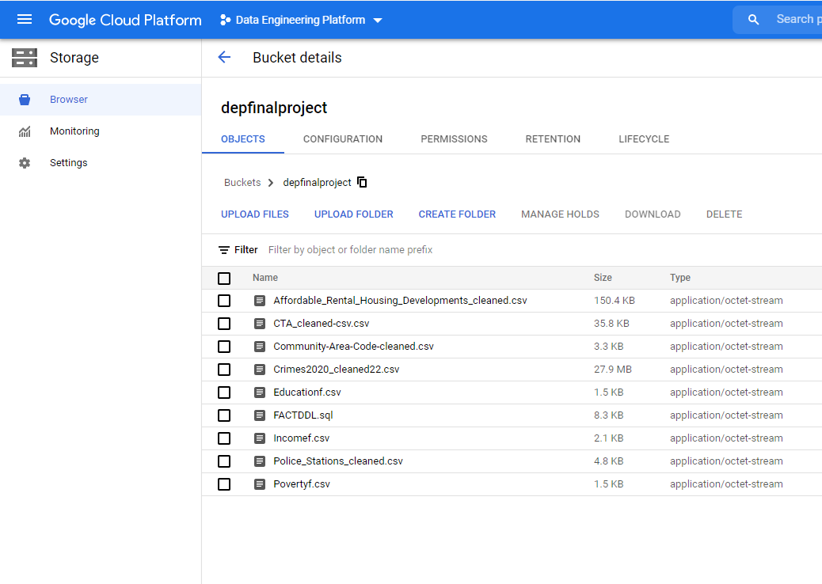
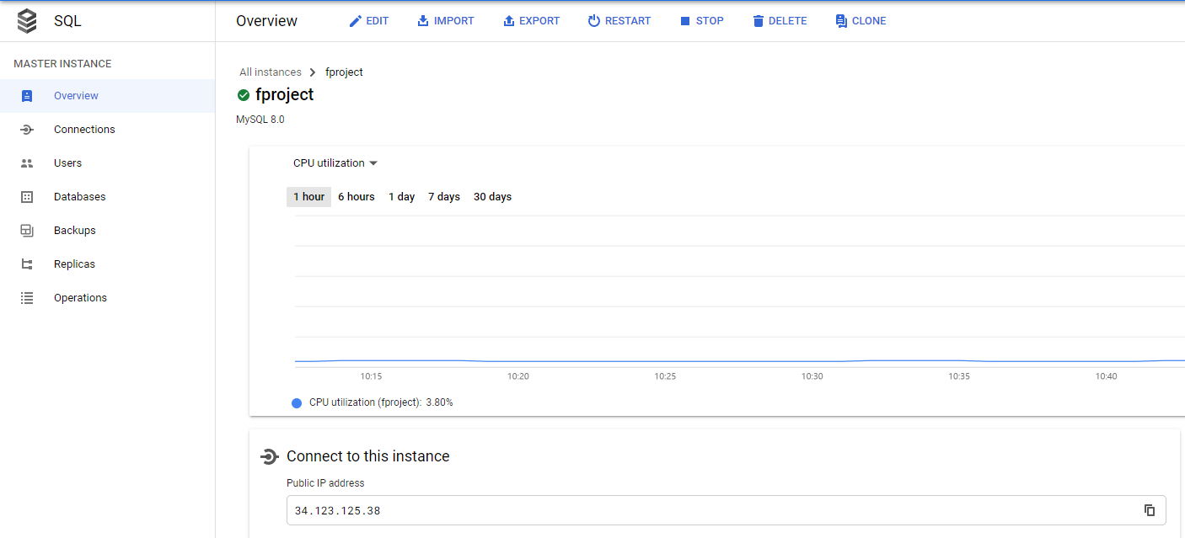
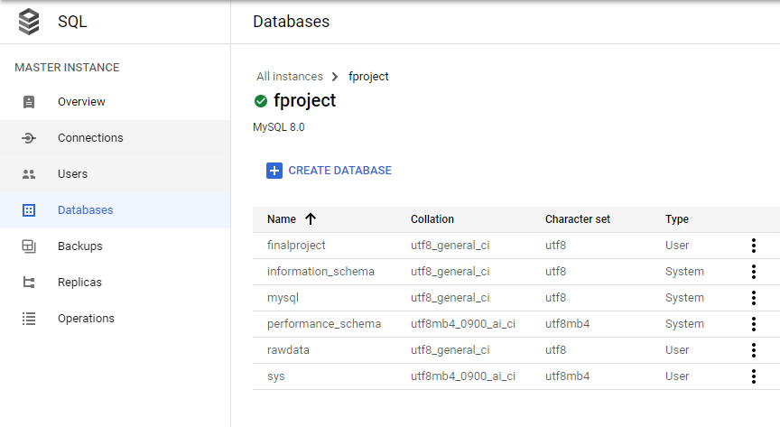
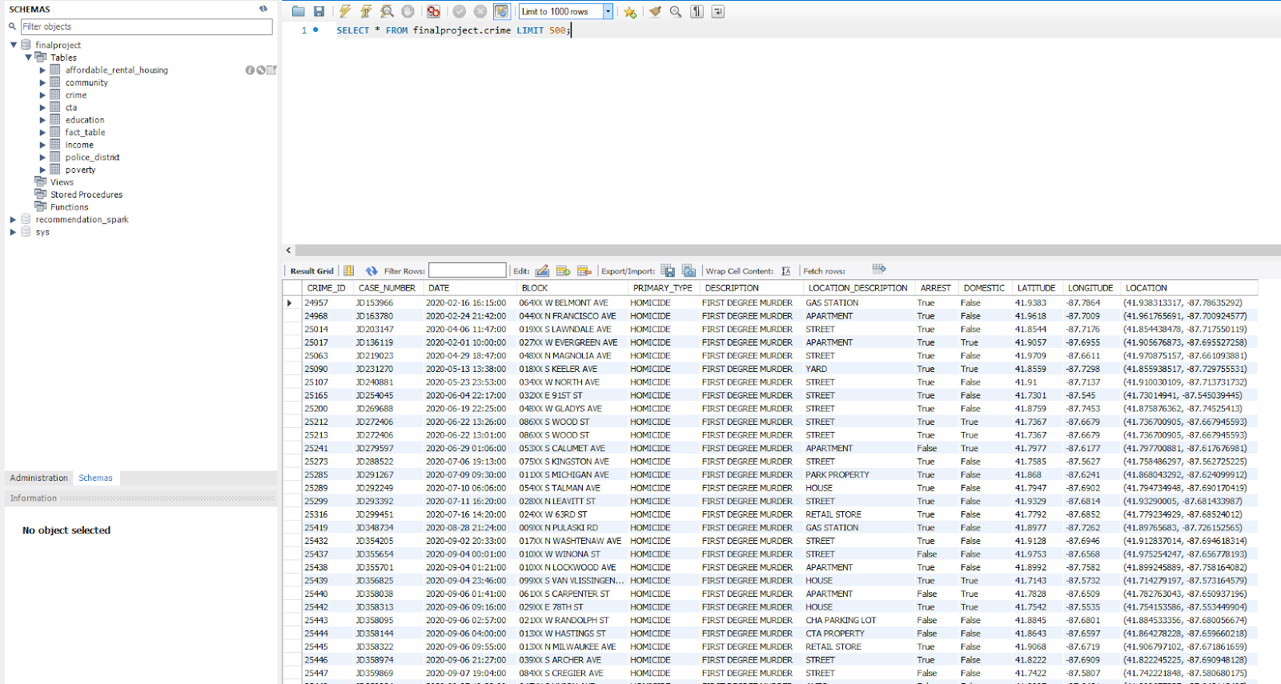
DATA STORAGE & CLOUD
Introduction
Solution Overview
ETL/Data Model
Insights
Conclusions

Slide 14
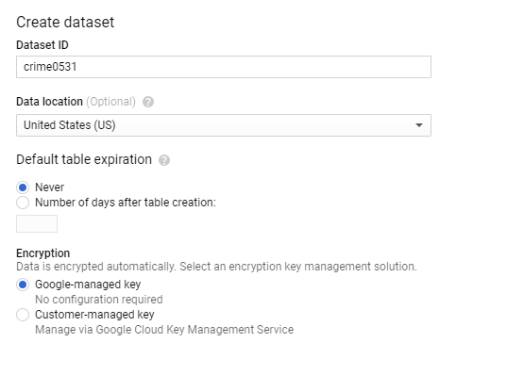
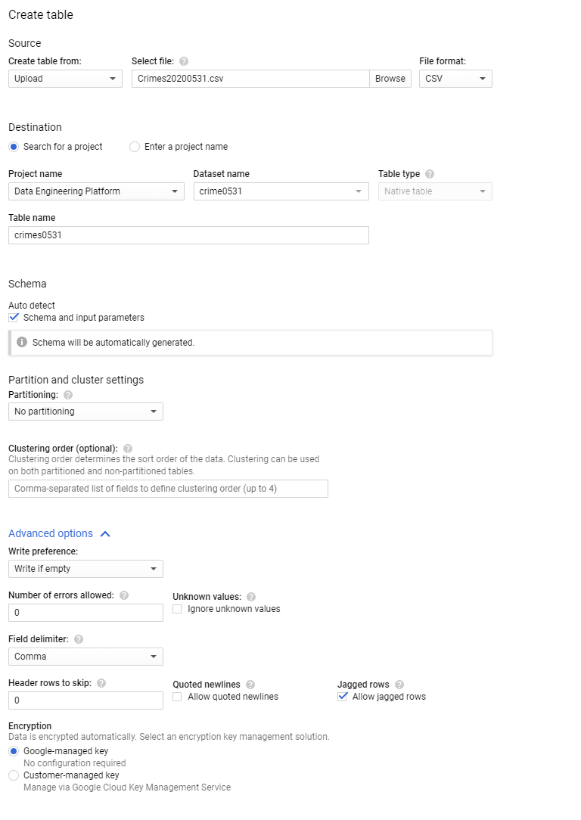
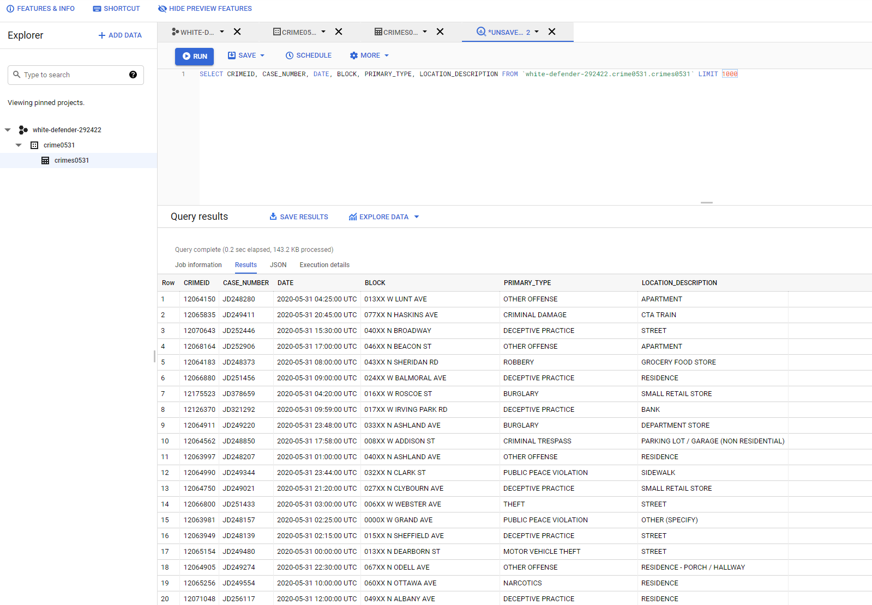
DATA STORAGE & CLOUD
Introduction
Solution Overview
ETL/Data Model
Insights
Conclusions

Slide 15
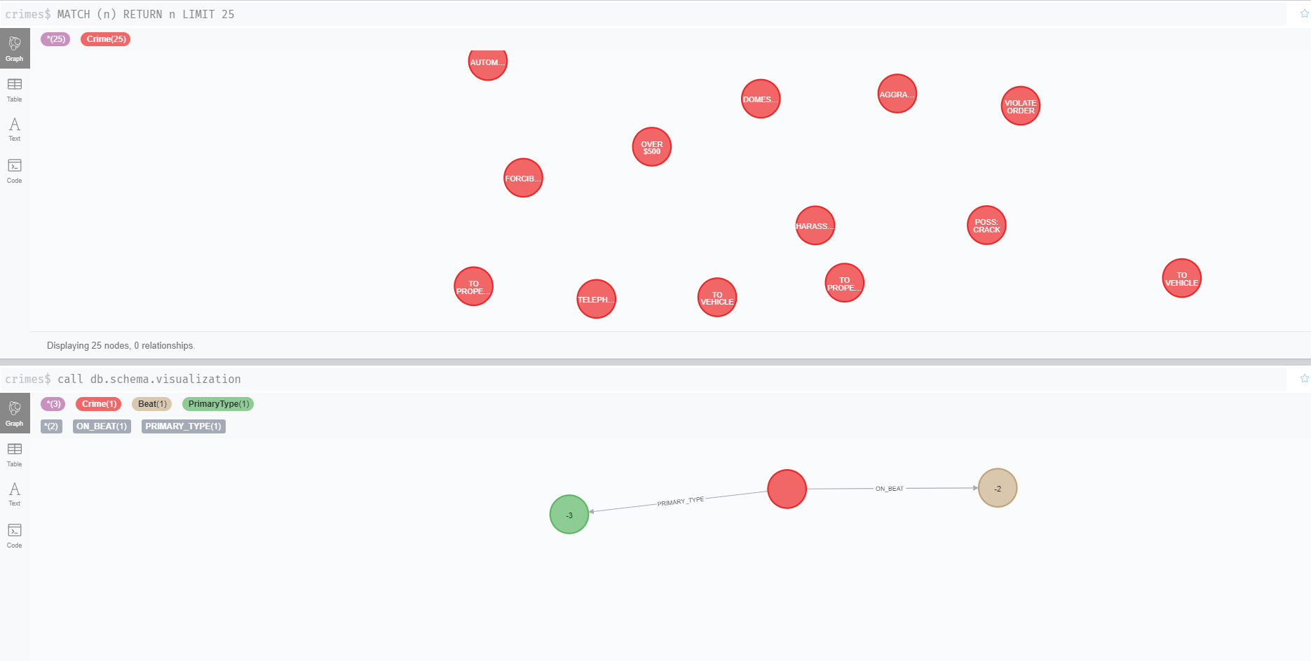
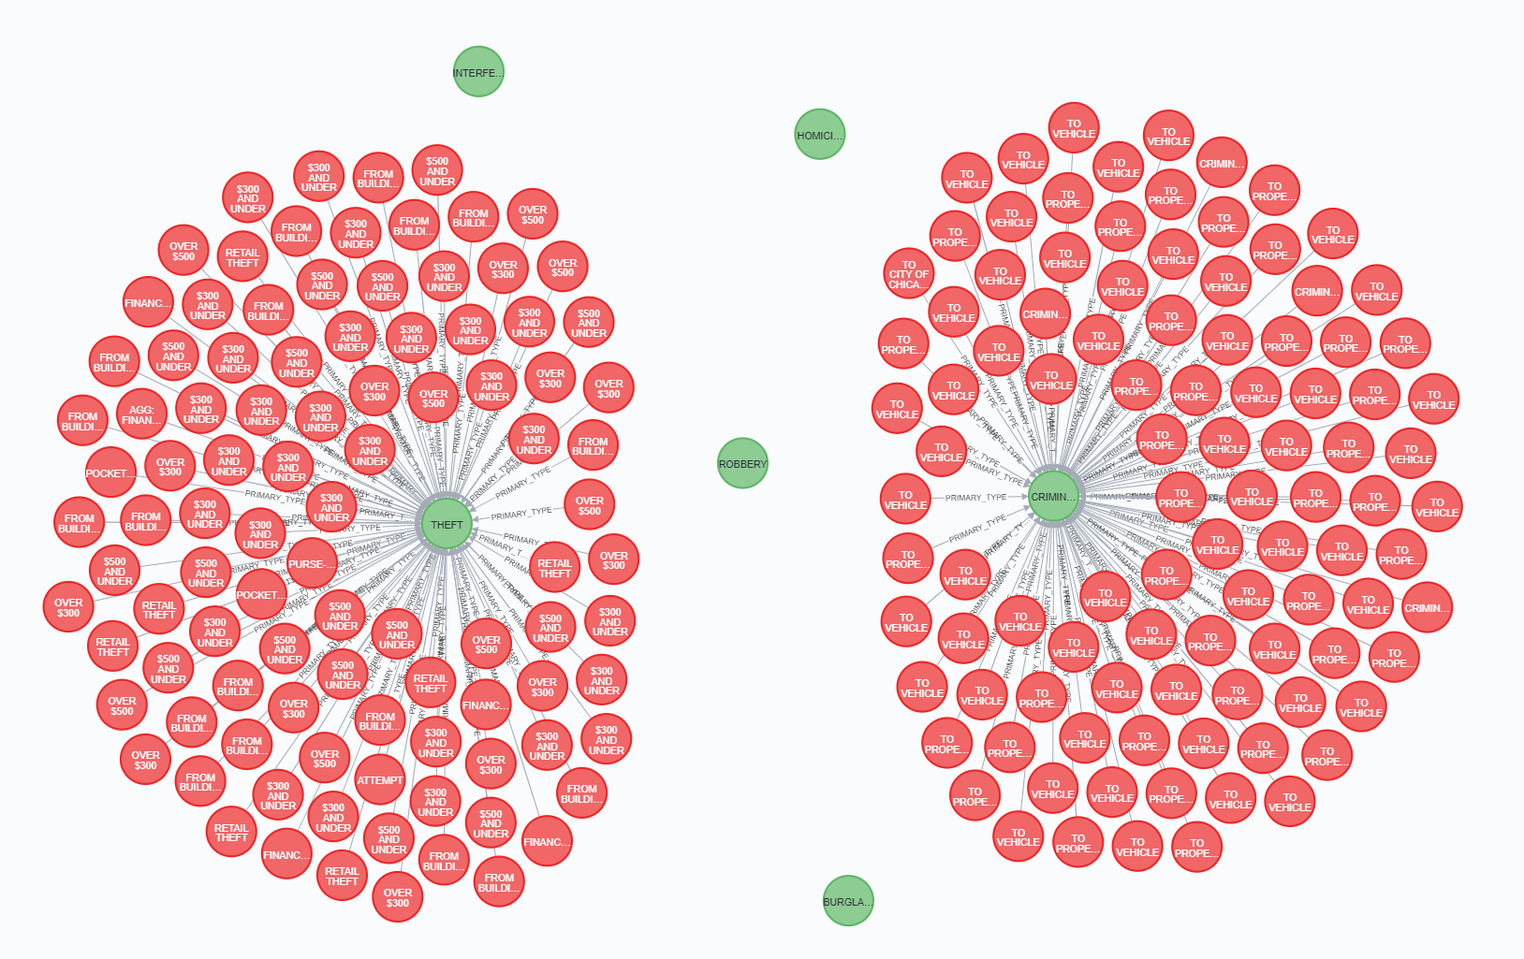
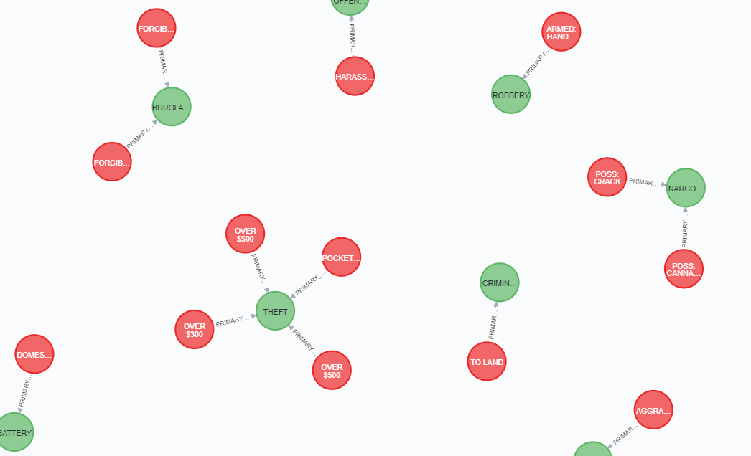
GRAPH DATABASE: NEO4J
Introduction
Solution Overview
ETL/Data Model
Insights
Conclusions

Slide 16
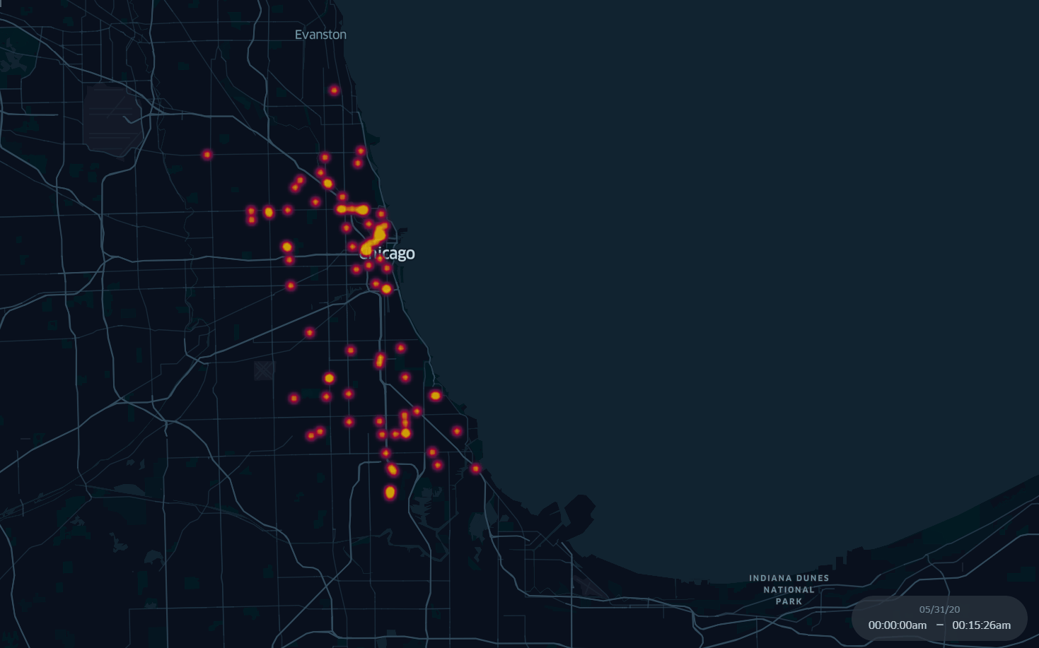
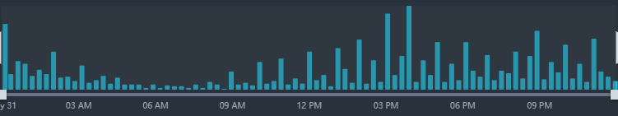
ONE DAY IN CHICAGO
Introduction
Solution Overview
ETL/Data Model
Insights
Conclusions
Heat for Every 15 Minutes

Slide 17
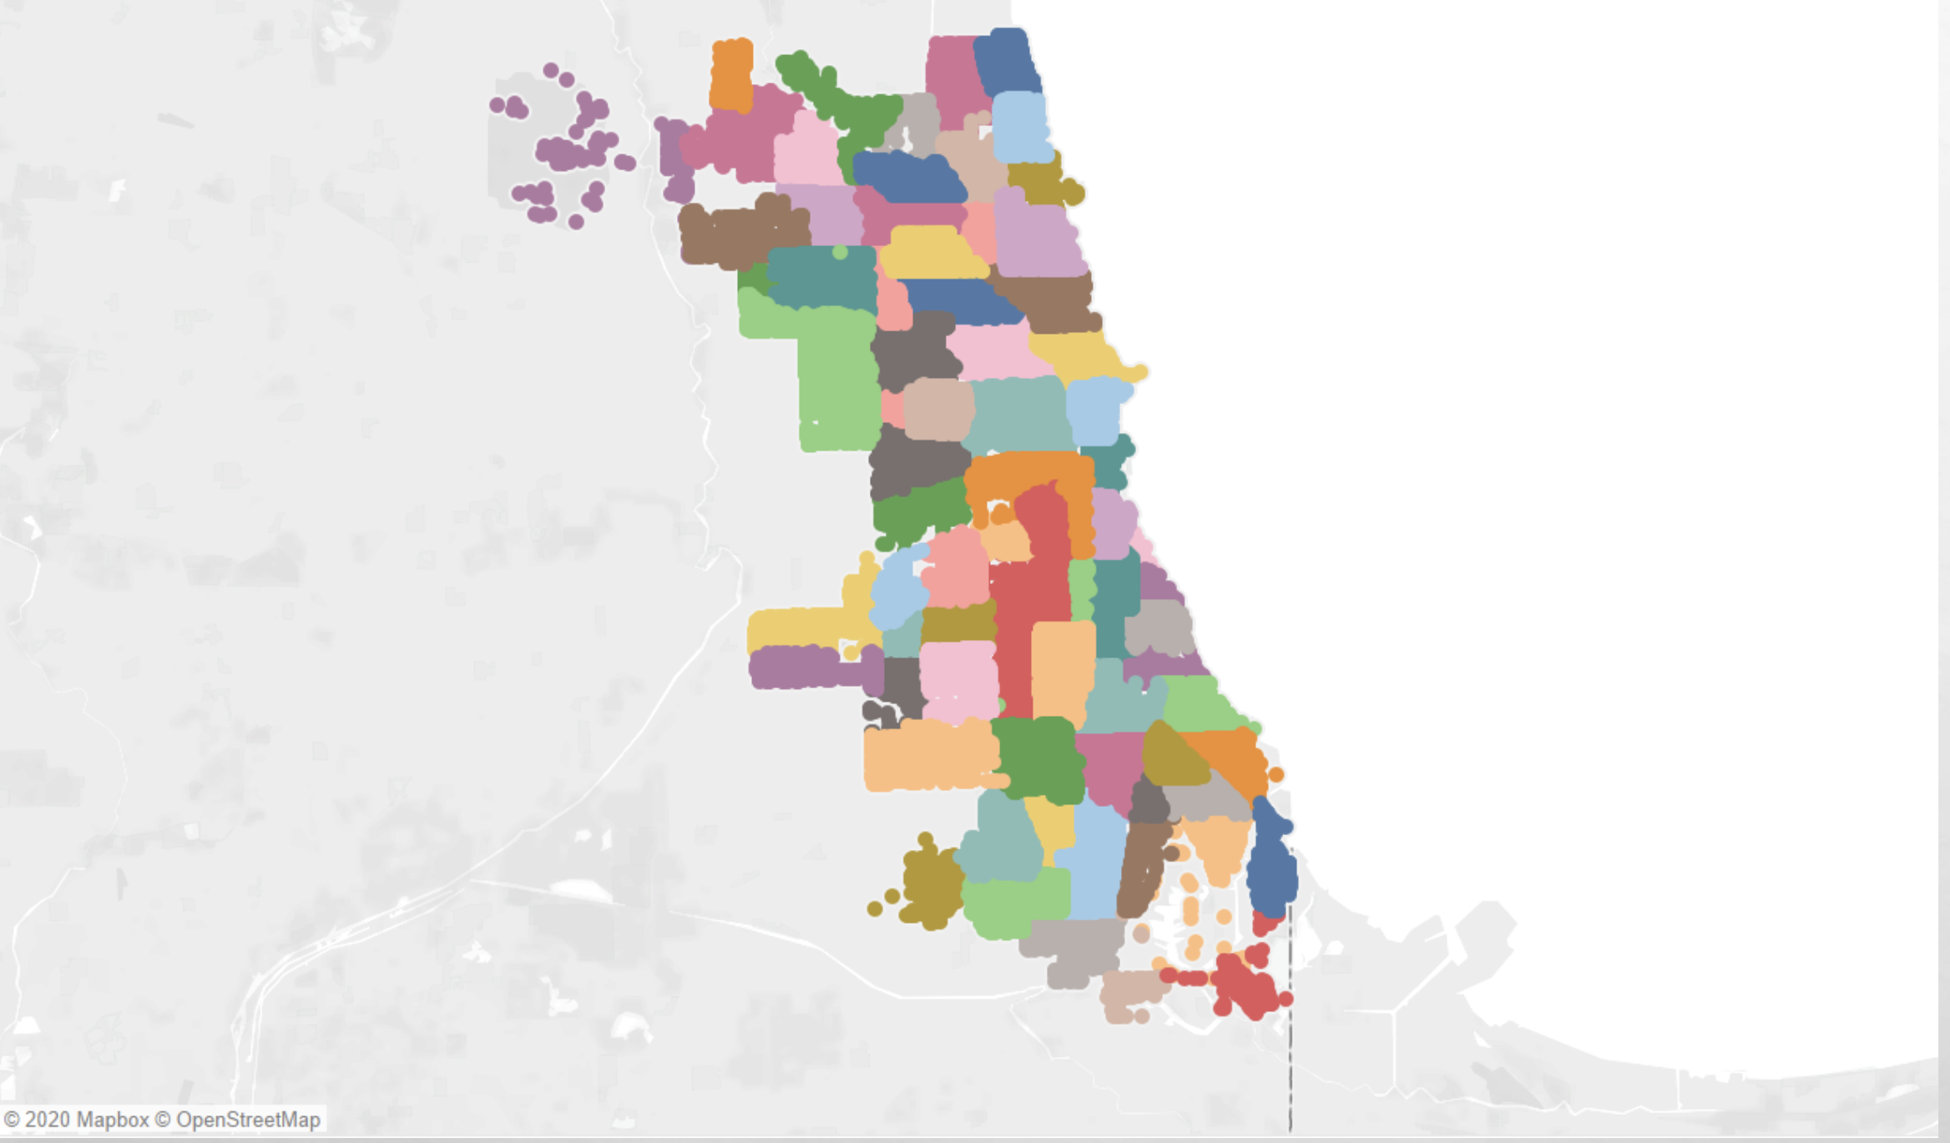
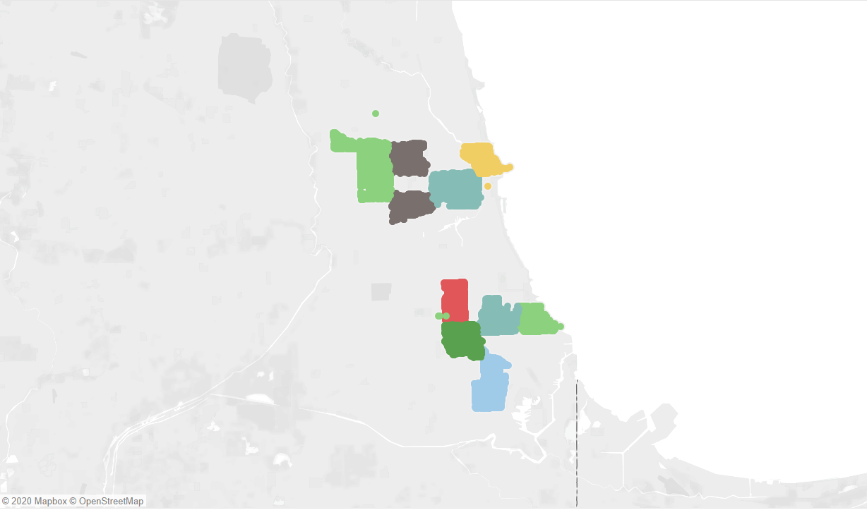
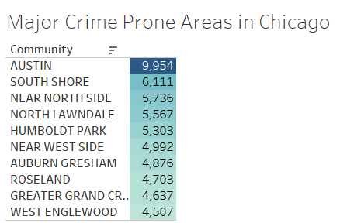
Major Crime Prone Areas in Chicago
Introduction
Solution Overview
ETL/Data Model
Insights
Conclusions

Slide 18
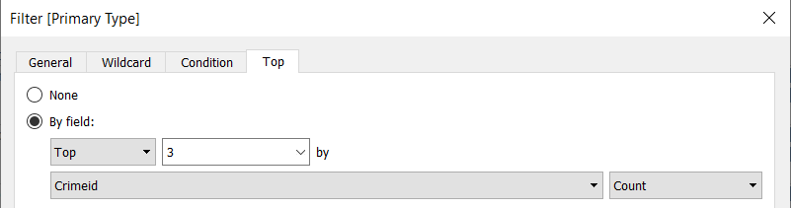
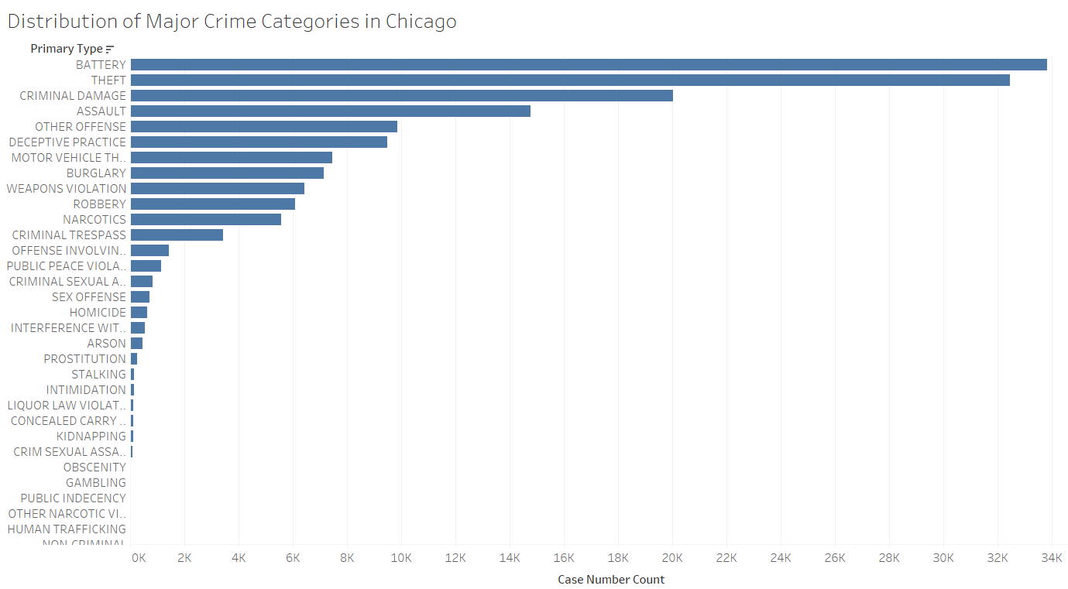
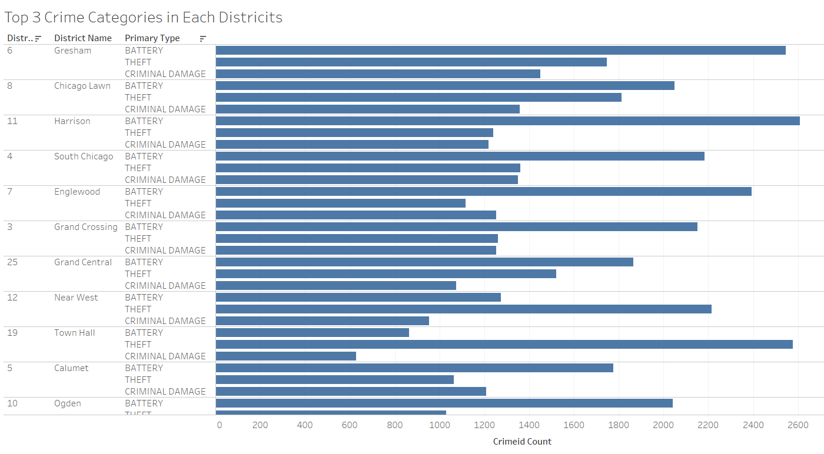
Major Crime Issues in Chicago
Introduction
Solution Overview
ETL/Data Model
Insights
Conclusions
Major Crime: 1. Battery 2. Theft
3. Criminal Damage 4. Assault
“Battery” : the actual physical violence causing the physical harm.
“Assault”: the act which causes the victim to apprehend imminent physical harm
“Criminal Damage”: unauthorized destruction of public facilities or personal property

Slide 19
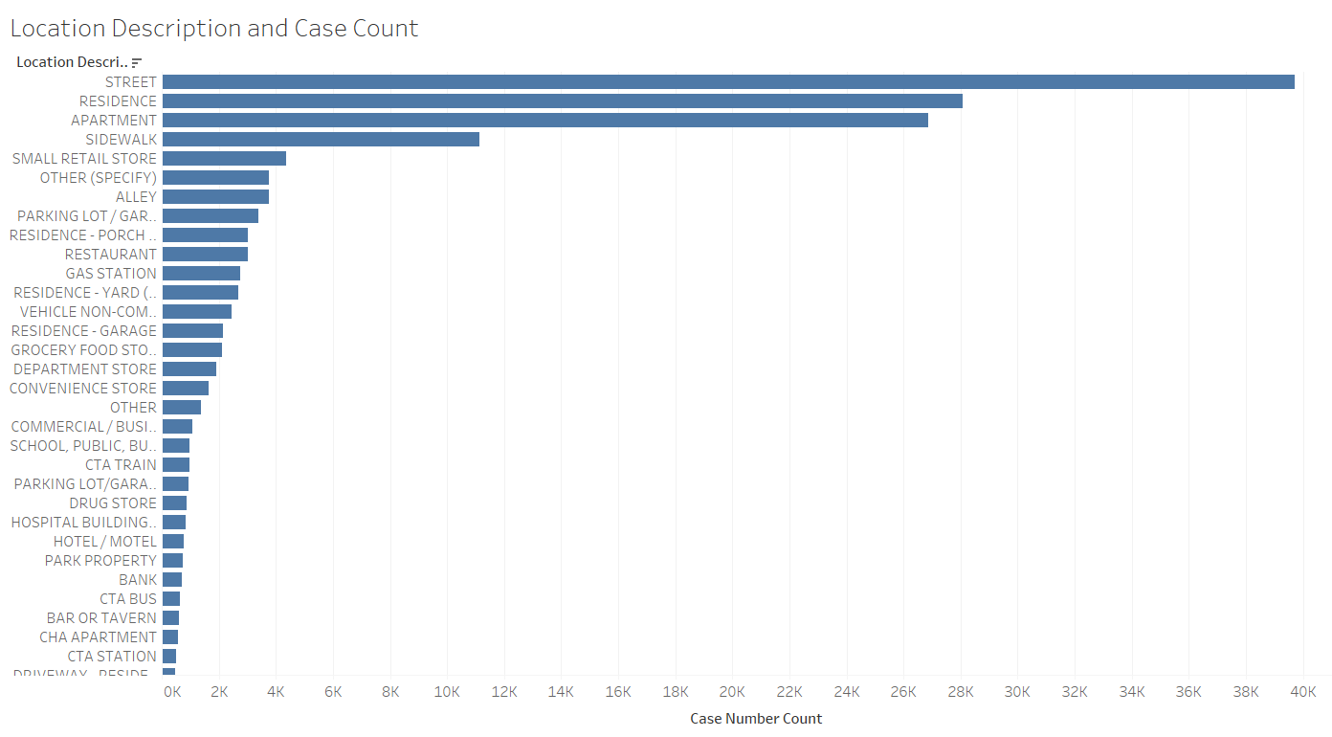
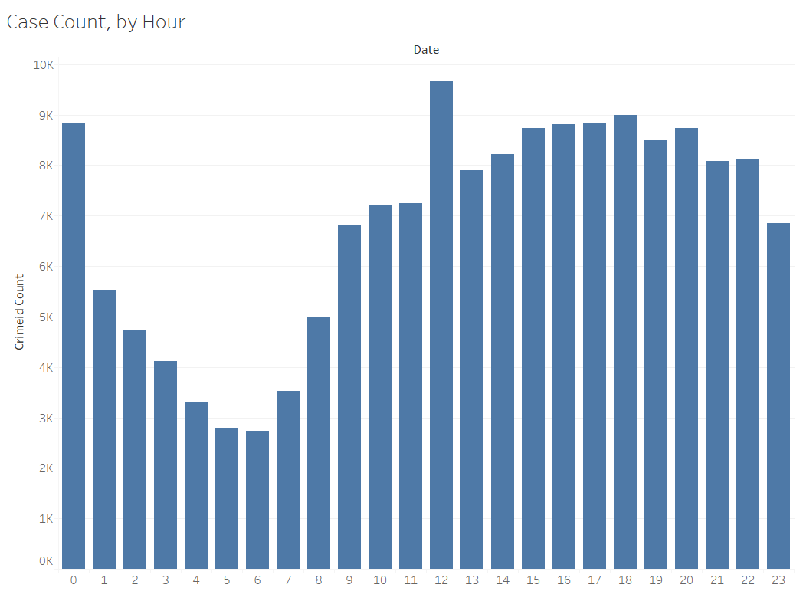
Introduction
Solution Overview
ETL/Data Model
Insights
Conclusions
Major Crime Prone Locations and Time in Chicago
Crime prone time: 12 noon, 3 to 6 pm, 0 am, 7 to 8 pm
Crime prone locations: 1. residential & apartment, 2. street & sidewalk, 3. small retail stores

Slide 20
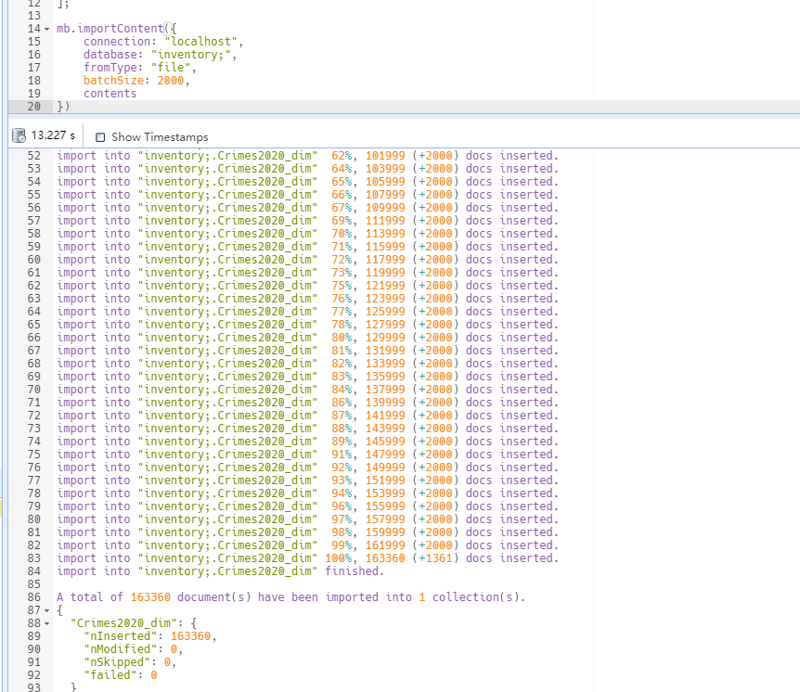
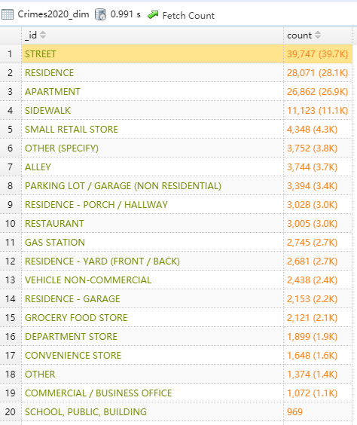
Top 20 Districts and Community locations in MongoDB
Introduction
Solution Overview
ETL/Data Model
Insights
Conclusions
Import cleaned Crime dataset
Top 20 crimes by location description

Slide 21
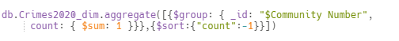
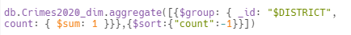
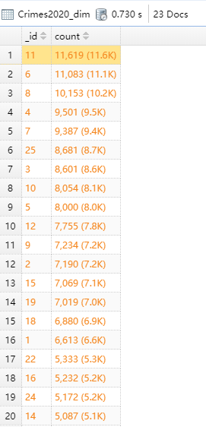
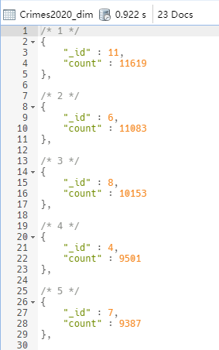
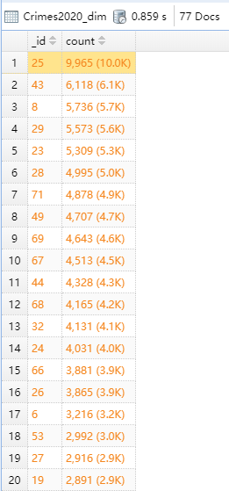
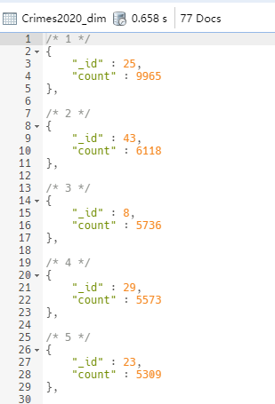
Top 20 Districts and Community locations in MongoDB
Introduction
Solution Overview
ETL/Data Model
Insights
Conclusions
Input
Output

Slide 22
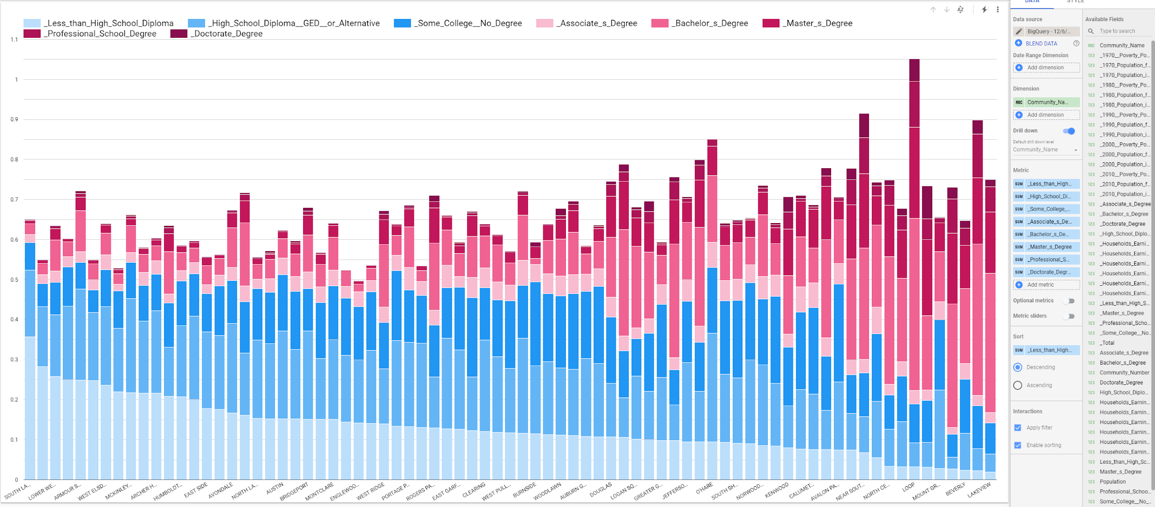
GCP BigQuery & Data Visualization Studio
Introduction
Solution Overview
ETL/Data Model
Insights
Conclusions

Slide 23
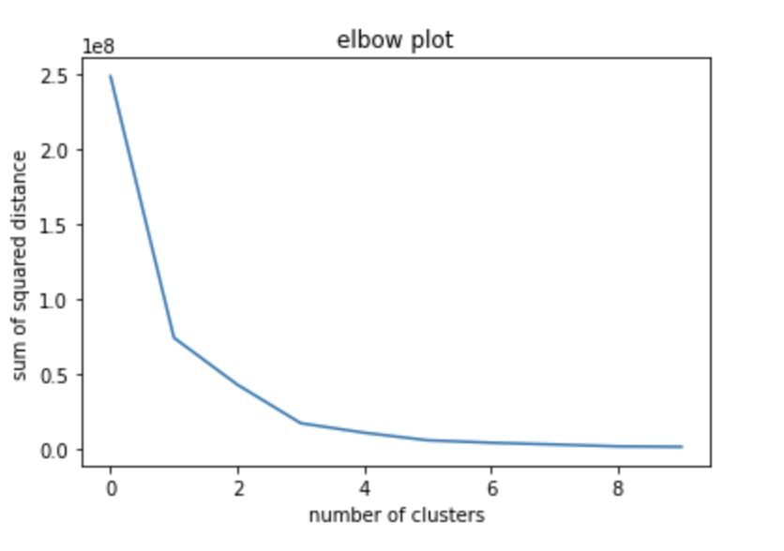
Clustering: K-Means
Introduction
Solution Overview
ETL/Data Model
Insights
Conclusions
Crime:
Community Area
Crime Count
Poverty:
2010 % Poverty Population
Education:
% Educated Population with No Degree
% Educated Population with No Degree
Income:
% Households Earning less than$49,999
% Households Earning between $50,000 and $99,999
% Households Earning more than 100,000

Slide 24
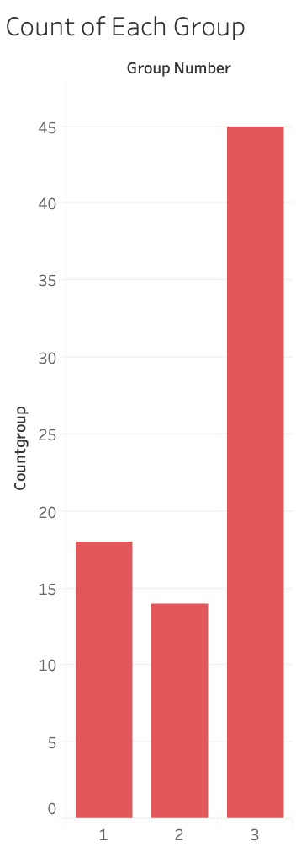
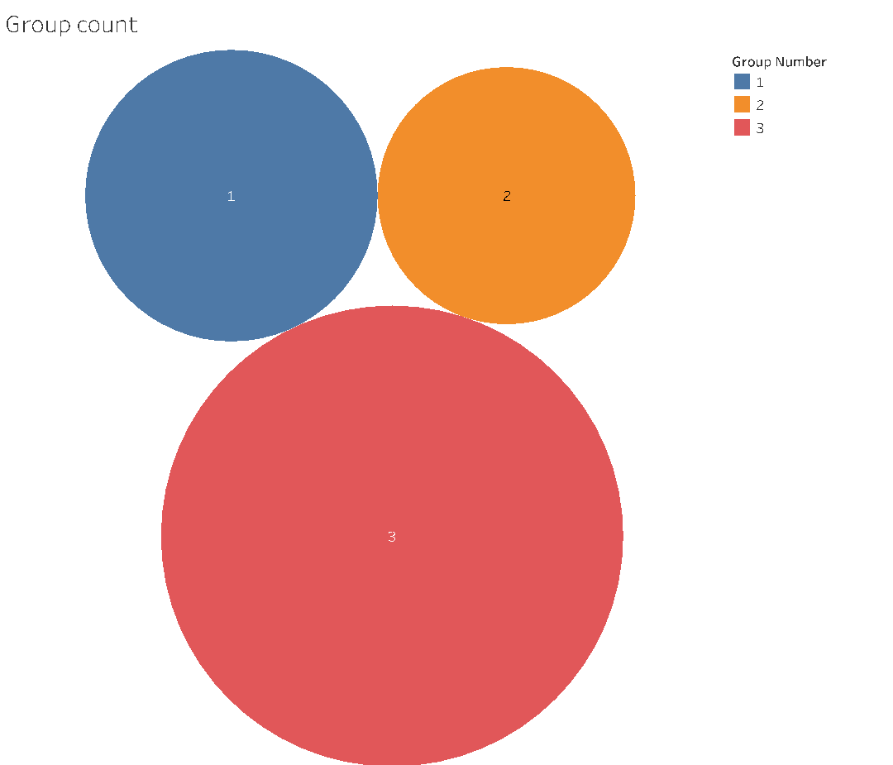
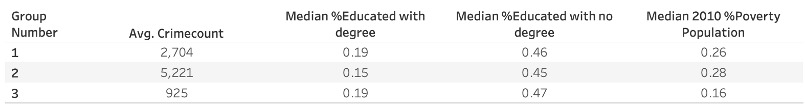
Crime Demographics & Group Comparison
Introduction
Solution Overview
ETL/Data Model
Insights
Conclusions
 | Group 2 | Group 3
Population | 699,274 | 1,068,348
Average Crime Count | 5,221 | 925
Median % Educated with Degree | 15% | 19%
Median % Educated with No Degree | 45% | 47%
Median % 2010 Poverty Population | 28% | 16%
Top 3 Crime Type | Battery; Theft; Criminal Damage | Theft; Battery; Criminal Damage

Slide 25
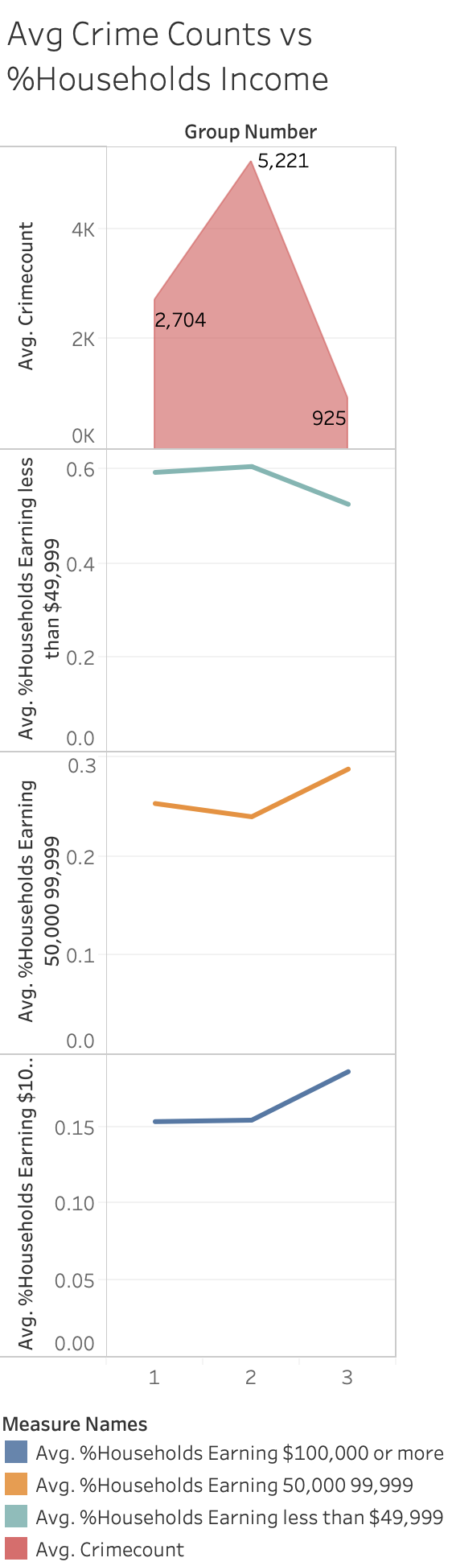
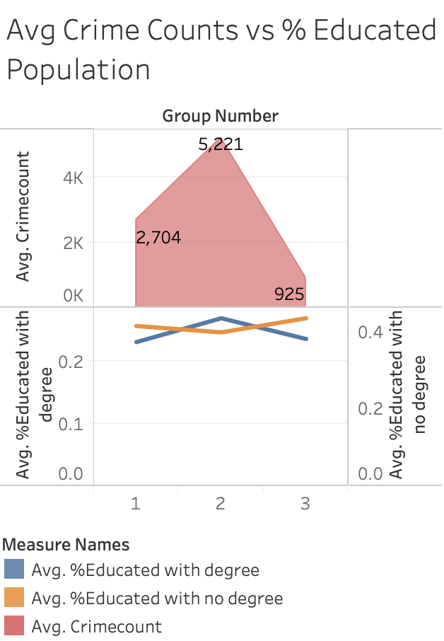
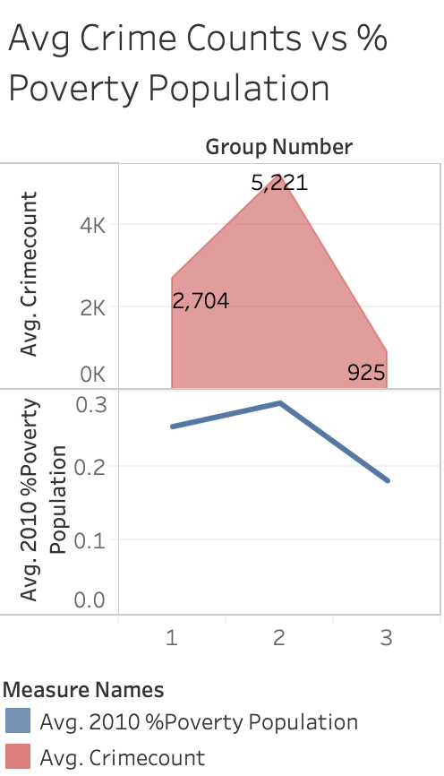
Avg Crime Counts vs % Educated Population， % Poverty Population & Households Income
Introduction
Solution Overview
ETL/Data Model
Insights
Conclusions

Slide 26
RECOMMENDATIONS
Introduction
Solution Overview
ETL/Data Model
Insights
Conclusions
Indexing for Performance :
· Add additional index to support frequent queries to enhance performance (e.g. community areas)
Design
Considerations
Data Integrity:
Add constraint foreign keys, auto increment primary keys in dimensional database to ensure data with references to related fields
Decrease possibility for missing or duplicating data.
Data Dimensions:
Apply snowflake schema for database, better support analysis.
Thoroughly reviewed Chicago Data Portal to identify possible dimensions and related attributes to crime case analysis.
Avoid data redundancies, inconsistencies and to ensure better maintenance of database.
Enhancements for Future Consideration:
Using GCP Compute Engine where possible to improve efficiency.
Getting more specific data of affordable rental housing and CTA and try to link with crime data to give a further analysis.
Analyzing the crime data across years.

Slide 27
LESSONS LEARNED
Introduction
Solution Overview
ETL/Data Model
Insights
Conclusions
Data Collecting and Cleaning:
Take down each step in the process, save files in chronological order.
Import .csv tables into MySQL and GCP require to ensure consistent data types.
Crime data is updated a few weeks later than they’re first uploaded, thus the latest data should be analyzed carefully.
Data Analysis Challenges due to Data Quality Issues :
Some data columns are frequently missing, we need to remove these lines before starting analyzing.
Demographic data are macro level data which is updated in a much longer period.
Some outliers may skew the average crime counts.
Team Work:
Meeting regularly and make sure each other is on the same page.
Follow the schedule and be open to share ideas.

Slide 28

THANK YOU!

Slide 29

APPENDIX

Slide 30
DATA SOURCES
DATA | DESCRIPTION
Chicago Public Safety – Crimes | Chicago city community level data of crimes such as crime time, type, location description and community area.
Chicago Public Safety - Police Stations | Chicago city community level data of police stations such as district, website and location.
Chicago Transportation - Metra Stations | Chicago city community level data of metra stations such as stop name and location.
Chicago Housing - Chicago Neighbourhoods | Chicago city community level data of housing such as property type, address, units and location.
Chicago Demographic-Chicago Neighbourhoods | Chicago city community level data of demographic information such as percentage of poverty population, percentage of population educated at different levels and percentage of population at different income levels.

Slide 31
References
Crimes 2020:
https://data.cityofchicago.org/Public-Safety/Crimes-2020/qzdf-xmn8
Data Size: 38.8 MB (Crimes_-_2020.csv)
Number of Observations/attributes: 22 variables
Chicago Police Stations:
https://www.chicago.gov/city/en/depts/cpd/dataset/police_stations.html
Data Size: 5.56 KB (Police_Stations.csv)
Number of Observations/attributes: 15 variables
System Information of CTA:
https://data.cityofchicago.org/Transportation/CTA-System-Information-List-of-L-StopsData/8pix-ypme/data
Data Size: 46.7 KB (CTA_System_Information_List_of_L_Stops.csv)
Number of Observations/attributes: 16 variables
Affordable Rental Housing Developments
https://data.cityofchicago.org/Community-Economic-Development/Affordable-Rental-Housing-Developments/s6ha-ppgi
Data Size: 174 KB (Affordable_Rental_Housing_Developments.csv)
Number of Observations/attributes: 14 variables

Slide 32
References
Chicago Demographic:
http://cn2015.net/district/bronzeville-south-lakefront/bronzeville-south-lakefront-district-data-analysis/
Data Size: 29 KB (Demographic.csv)
Number of Observations/attributes: 49 variables
Community Area Boundaries in Chicago:
https://data.cityofchicago.org/Facilities-Geographic-Boundaries/Boundaries-Community-Areas-current-/cauq-8yn6
Data Size: 1.91 MB (CommAreas.csv)
Number of Observations/attributes: 77 variables

Slide 33
DATA PROFILE - Crimes 2020
Rules:
“The unauthorized use of the words "Chicago Police Department," "Chicago Police," or any colorable imitation of these words or the unauthorized use of the Chicago Police Department logo is unlawful.”
All data visualizations on maps should be considered approximate and attempts to derive specific addresses are strictly prohibited

Slide 34
DATA PROFILE - Crimes 2020
File Naming Conventions Used: IUCR - The Illinois Uniform Crime Report Code
Data Quality Metrics: the Chicago Police Department does not guarantee the accuracy, completeness, timeliness, or correct sequencing of the information and the information should not be used for comparison purposes over time
Types of data used: Structured Data
Data Owner Police
Time Period 2001 to present, minus the most recent seven days
Frequency Data is updated daily, Tuesday through Sunday

Slide 35
DATA PROFILE - Chicago Police Stations
Rules: 1. Data users should include the following disclaimer at the site where the software application, or other secondary or derivative application can be accessed or downloaded:
“This site provides applications using data that has been modified for use from its original source, www.cityofchicago.org, the official website of the City of Chicago. The City of Chicago makes no claims as to the content, accuracy, timeliness, or completeness of any of the data provided at this site. The data provided at this site is subject to change at any time. It is understood that the data provided at this site is being used at one’s own risk.”
Comply with any additional Terms of Use set forth by the City agency or department providing data used by the software application, or other secondary or derivative application, including, without limitation, requirements to include additional citations or disclaimers at the site where the application can be accessed or downloaded.

Slide 36
DATA PROFILE - Chicago Police Stations
Rules: 2. To the fullest extent permitted by law, any user of the data provided at this website shall indemnify and hold harmless the City from any claim, loss, damage, injury, or liability of any kind (including, without limitation, incidental and consequential damages, court costs, attorney’s fees and costs of investigation), that arises directly or indirectly, in whole or in part, from that user’s use of this data, including any secondary or derivative use of the information provided herein. Every user of this data also specifically acknowledges and agrees to have an immediate and independent obligation to defend the City from any claim that may fall within this indemnification provision, even if the allegations are or may be groundless, false or fraudulent, which obligation arises at the time such claim is tendered to the user by the City and continues at all times thereafter.

Slide 37
DATA PROFILE - Chicago Police Stations
File Naming Conventions Used: None.
Data Quality Metrics: The City of Chicago (“City”) voluntarily provides the data on this website as a service to the public. The City makes no warranty, representation, or guaranty as to the content, accuracy, timeliness, or completeness of any of the data provided at this website.
Types of data used: Structured Data

Slide 38
DATA PROFILE - System Information of CTA
File Naming Conventions Used: DIRECTION_ID - Normal Direction of train traffic at platform
Data Quality Metrics: The data provides location and basic service availability information. Updated at May 15, 2018, the latest data can be found through Chicago Data Portal for rail stations. The content of the data, such as Stop Name and Stop Location, does not change over time.
The license for this dataset is unspecified
Types of data used: Structured
Data Owner Chicago Transit Authority

Slide 39
DATA PROFILE - Affordable Rental Housing Developments
Rules: The list is provided as a courtesy to the public. No rule is available.
Data Quality Metrics: The latest update is on July 23, 2020. Data are updated only as needed. The list does not include every City-assisted affordable housing unit that may be available for rent, nor does it include the hundreds of thousands of naturally occurring affordable housing units located throughout Chicago without City subsidies.
Types of data used: Structured
Data Owner Housing and Economic Development
Time Period Current as of March 2013
Frequency Data are updated as needed

Slide 40
DATA PROFILE - Chicago Demographic
File Naming Conventions Used: Names of variables are easy to understand.
Data Quality Metrics: The majority are historical data about information before 2016. In terms of accuracy, data in each indicator do not change over time and are correct. However, in terms of consistency, although the data provide certain insights, they are not very much consistent with the data of crimes in 2020
The data include each community’s demographic information – poverty, education and income. Neighborhoods are in a constant state of change. Data for the built environment informs about existing conditions and allows for comparisons across neighborhoods and against citywide averages and helps to determine what backgrounds are in each community.
Types of data used: Metadata, Structured Data

Slide 41
DATA PROFILE - Community Area Boundaries in Chicago
Rules: The permissions of using the data are granted to the public.
Data Quality Metrics: The latest update is on Dec 18, 2018. The data content is fixed. Since the distribution of the Chicago area has not changed in the last two years, the data is not out of date. The data tends to be accurate because the difference between the region segmentation and the satellite images is not large.
Types of data used: Metadata
Data Provided By City of Chicago
Source Link http://www.cityofchicago.org
Time Period Current community area boundaries.
Frequency Updated as needed.

Slide 42
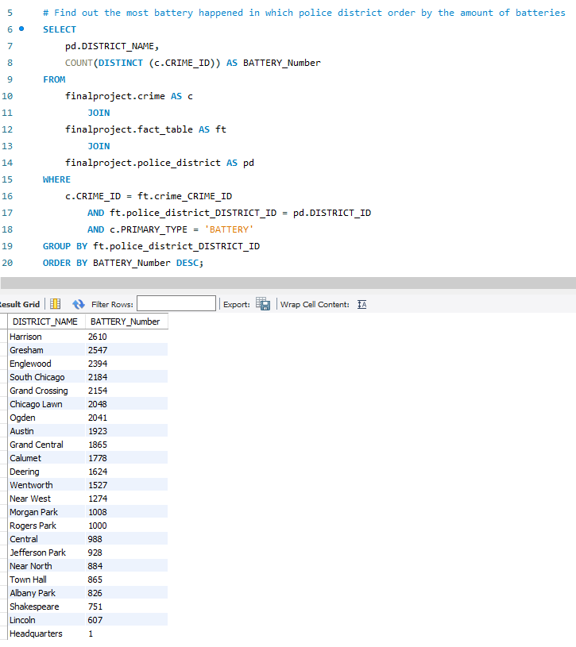
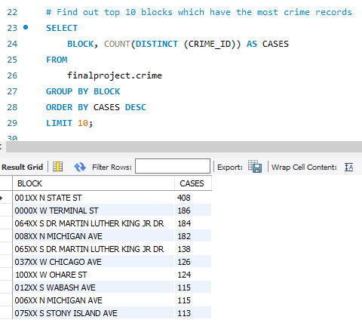
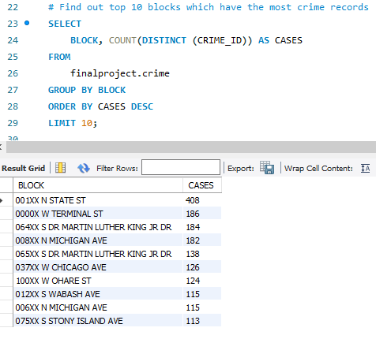
SQL Queries

